Slide 1
Foras Promineo Software

Slide 2
Helpful References
https://pycubed.org/
Site for all things pycubed. Very good Documentation by Max Holliday
https://github.com/pycubed/forums/discussions
Forms where a lot of people have asked relevant questions

Slide 3
Preferred IDE for Satellite Coding
Visual Studio Code
With Python extension and PyLint extension
Pylint needs to be played with a little bit

Slide 4
Using GitHub for code sharing
Installing GitHub desktop
Making a folder on your Z-drive
Forking the repository
Pushing changes to the master branch

Slide 5
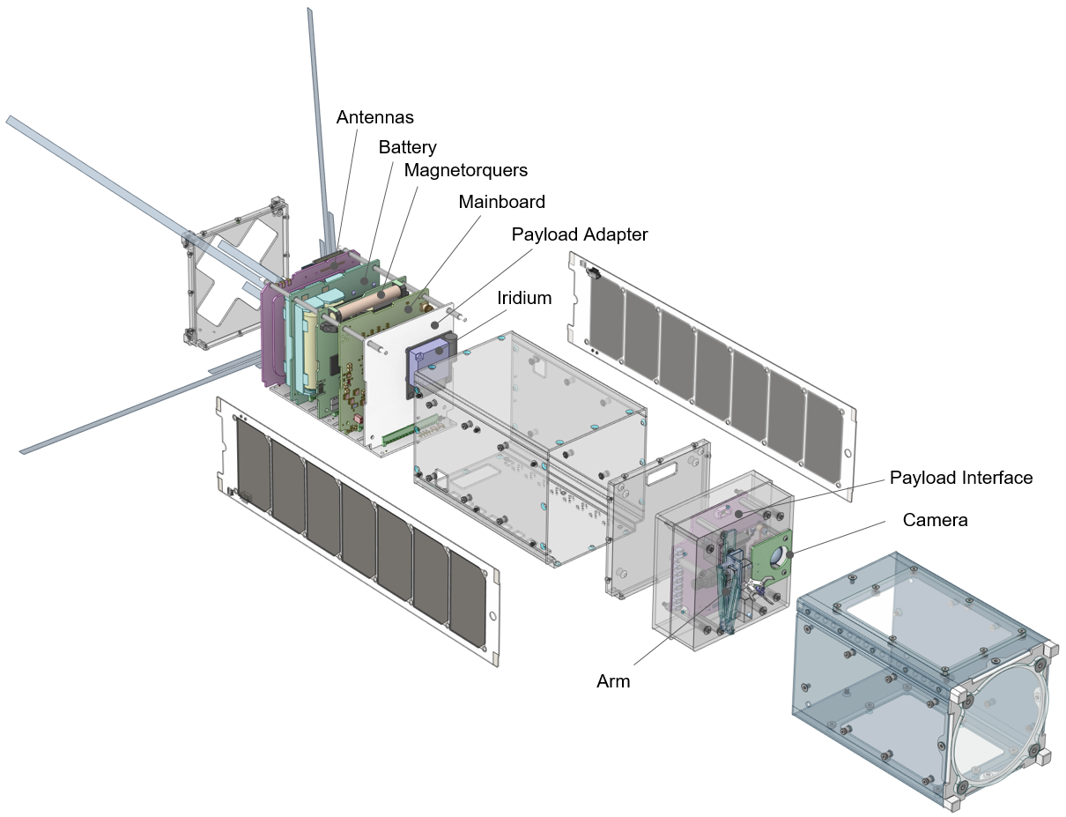
What is a Cubesat / Foras Promineo

Slide 6
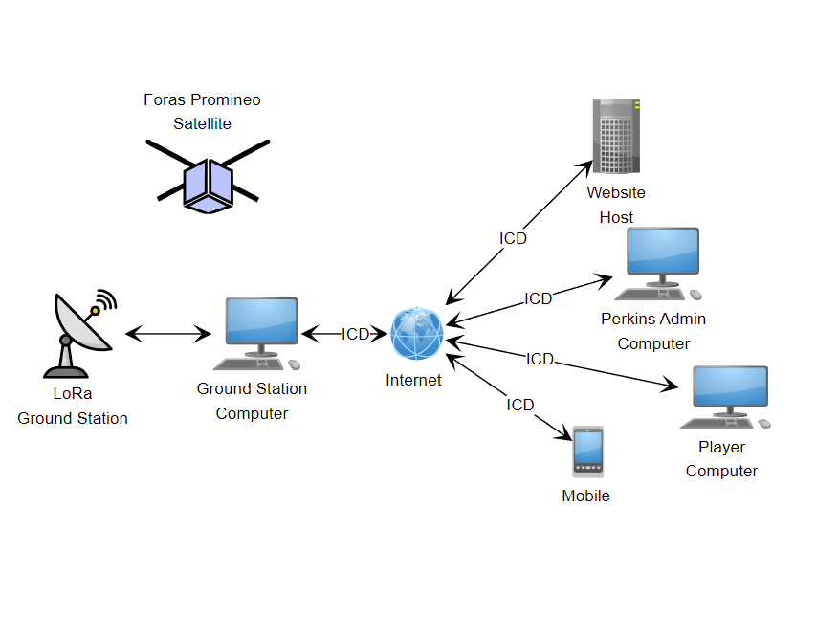
Space Operation
Satellite Software
Controls sat
Manages radio comms
Handles commands from Ground Station
Website
Shows “live” camera data
Allows user keyboard inputs
LoRa Ground Station
Sends and receives radio comms to/from satellite and ground station computer
Points ground station antenna at sat during flyover
Ground Station Computer
Send/Receive radio data from ground station
Sends payload data to website
Receives player input from Website

Slide 7
Con-ops
Host PC software (for debugging and testing on the ground)
Ground Station PC Software
Ground Station LoRa software
Satellite Software
Website

Slide 8
Satellite Software Preface
Satellite programming is mostly in CircuitPython. Firmware is written in C.
Satellite programming is for a MICROCONTROLLER, so it is MUCH less powerful and fast than a PC!!
during normal execution there is <1MByte of RAM available for task execution.
Floating point is MUCH slower than integer operations
Data transactions over the radio are limited to 256 byte packets.
UART interface to payload is running at ~115600 baud
Good practice is to just be mindful of what resources / typing your code is using.
Since python is dynamically typed, type casting in this application is quite important!
i.e. differences between a bool, int, float, char, and string object.
Also be aware of various decorations like the 0x (hex) or b’’ (binary) prefix, or @property.setters

Slide 9
Satellite Software Preface (cont.)
A lot of the background lower-level libs have been written by Max Alvarez (guy who developed PyCubed architecture) and Caden (me)

Slide 10
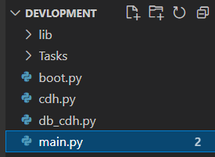
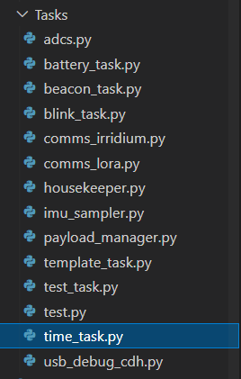
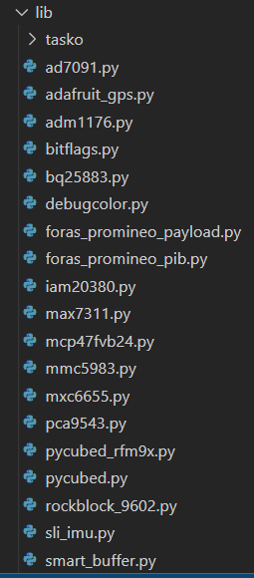
Project File Structure
Lib Directory:
All lib files for usage.
Top Level:
cdh, boot, and main files
Task Directory:
Tasks

Slide 11

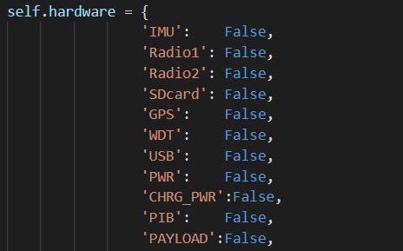
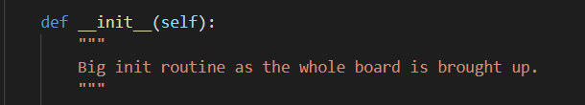
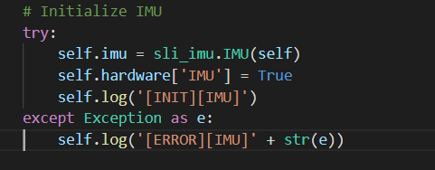
Master Library
Init routine initializes each device in self.hardware
Each initialization for the devices is within its own try – except clause.
Hardware dictionary for each device in this library
Example device init.

Slide 12
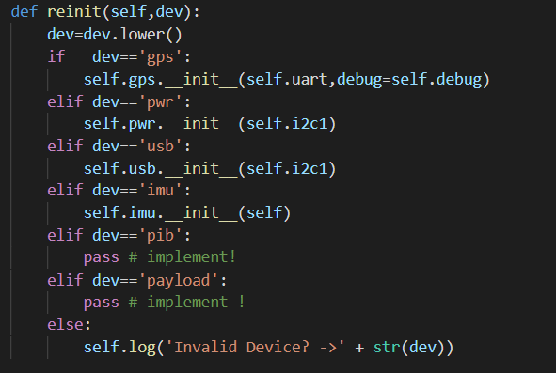
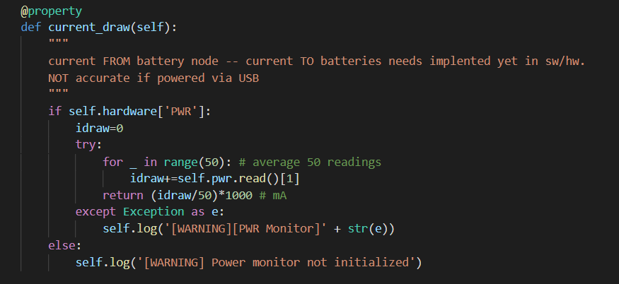
Master Library (cont.)
Reinit (very important)
Example of a property, i.e. class variable

Slide 13
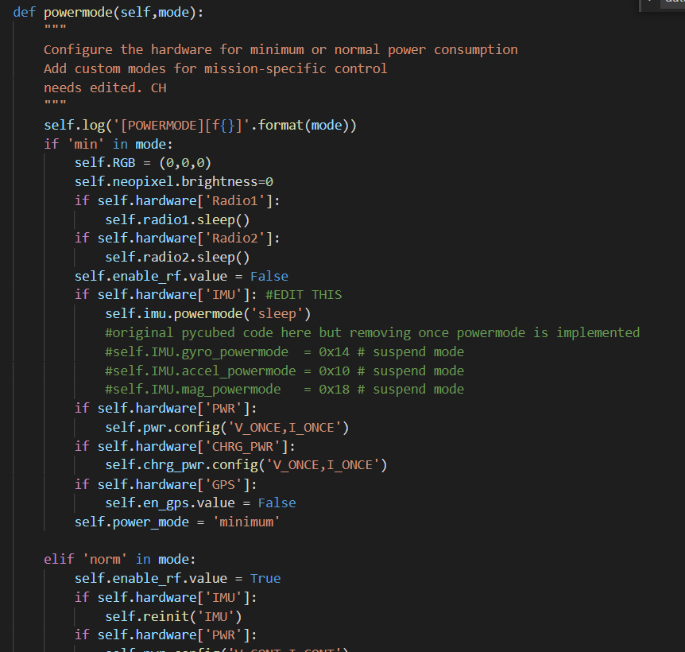
Master Library
Power mode setting

Slide 14

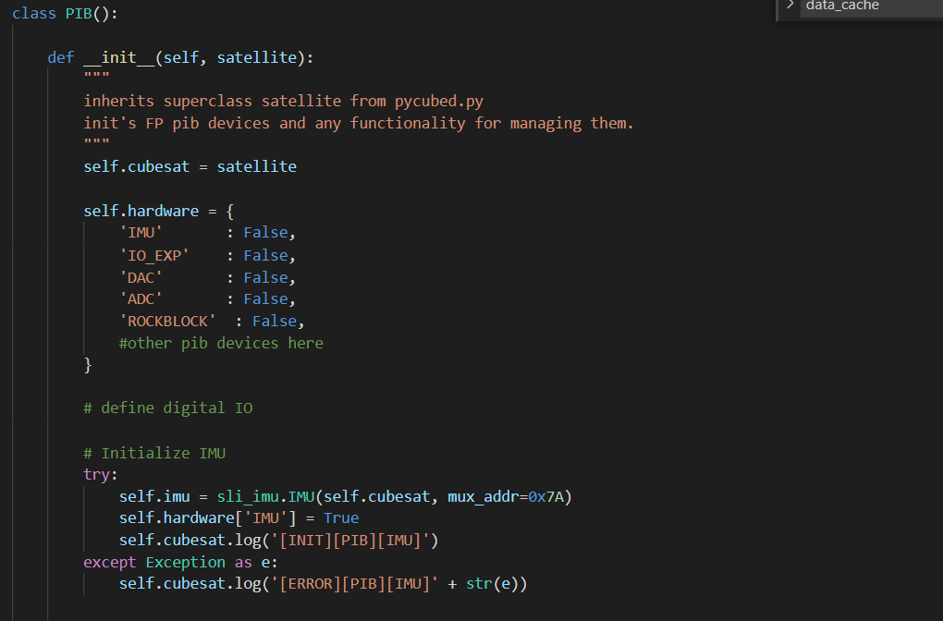
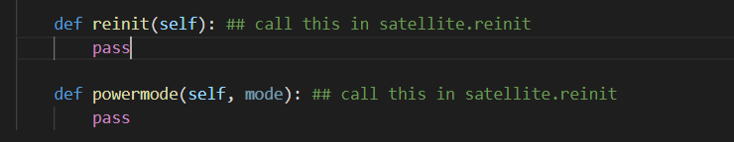
Sub library example

Slide 15
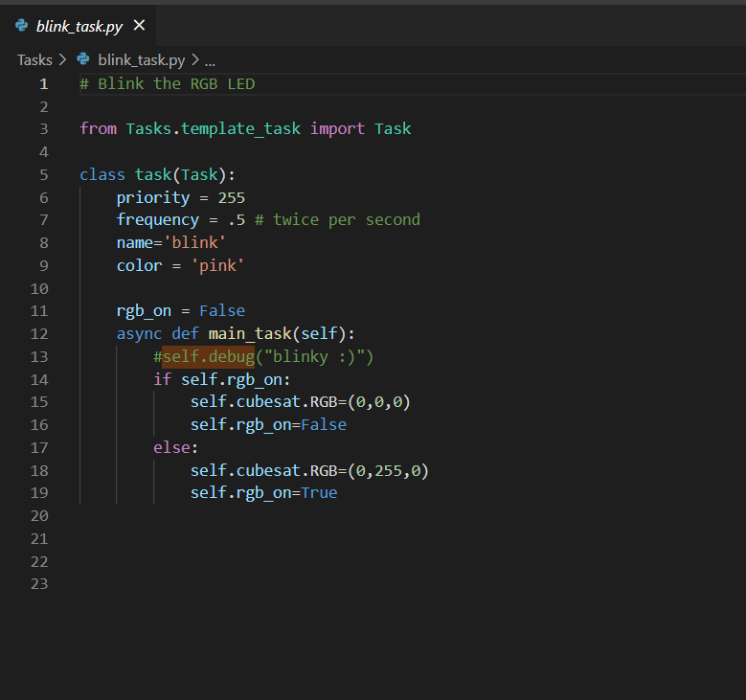
Anatomy of a Task
The mainboard executes tasks via a task scheduler
This is a task that blinks the led.
It is a subclass of task from template_task.py
When the task is executed, it runs the code within main_task.
Pycubed.py is self.cubesat
See priority and frequency for setting when a task will run.
To change priority and frequnency methods change_priority() and change_rate() must be called.

Slide 16
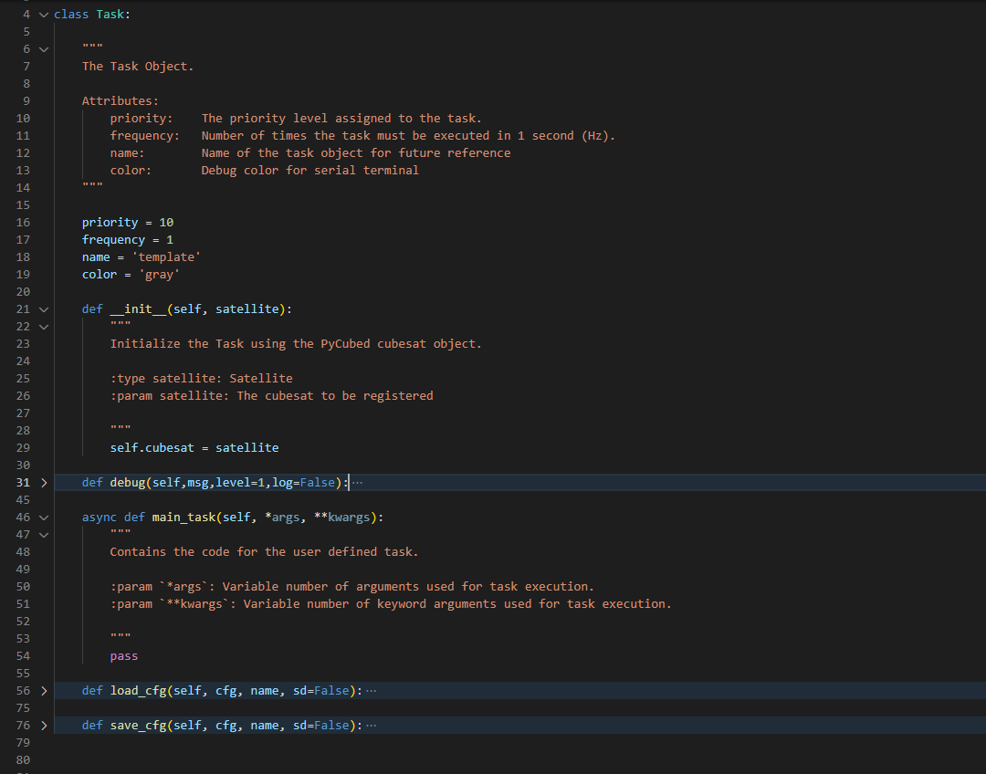
template_task.py: the parent class to all tasks.
Some tasks may need a custom __init__ procedure
Every class can call debug() to print data to the terminal and optionally log it.
Load and save config are currently being tested. Not implemented for most tasks. These can be used for the cubesat to change task options mid-flight.

Slide 17
Current Progress (as of 6/1/21)
Mainboard is functional and all peripherals are coded in.
A new design revision will be made soon with some new features and some pinout changes.
Payload interface board libraries in progress
~90% complete, waiting on some parts and another design rev for the final design
Tasks have been started, but nothing of true substance there just trying to get a good background set up
Some PC/website software has been written.

Slide 18
Things to Do:
Define operating states and what tasks should run at what times
Code high-level functionality
i.e. all the tasks, commands, data handling
Define radio>mainboard>payload data exchange for target bitrate
Test it for extended periods extensively
Make sure all code written is executed successfully on ground
Fault handling is EXTREMELY important in this application
Code pc host software to display live telemetry and simulate operations
Code PC ground station software

Slide 19
Phase 1 Plan
Pair 1 will define and code simulation and data interface to host PC (main priority #2)
We image a python program with a gui and real-time telemetry data updating, Marek started something like this but it really only uploaded new code to the device
Pair 2 will define and start to code the payload operation (main priority # 1)
Will be discussed in a moment
Once host software is in a good state, it can start to be tested by Pair 1 Implementing the ADCS (main priority #3)
Prioritize a minimum-functional implementation before coding in more sophisticated functionality:
For example, we would like to receive a stream of data from the openMV before there is error handling for dropped packets on the radio.

Slide 20
USB Interface
Mainboard
Host PC
Circuitpython REPL terminal
Read debug data to display on GUI
Circuitpython REPL
All debug data is also printed here
USB
Usb_cdc.terminal
Usb_cdc.data
Db_cdh and simulation handling
Read/send cb_cdh and simulation commands

Slide 21
Top Level Simulation / Debug Interface Flowchart
Phase 1 Goal
Mainboard
Debug/ Host Interface
Host PC
Usb connected?
Send db_cdh commands to device from user GUI and/or terminal
No
Yes
Set all simulation flags to 0
Look at usb_cdc.data port for new command
Execute command if detected
Value simulation flag True?
Query host for simulation data
Send queried simulation value over
Mainboard
Simulation Interface
Debug Data Stream Output
Gather data from Debug data stream and display on GUI nicely

Slide 22
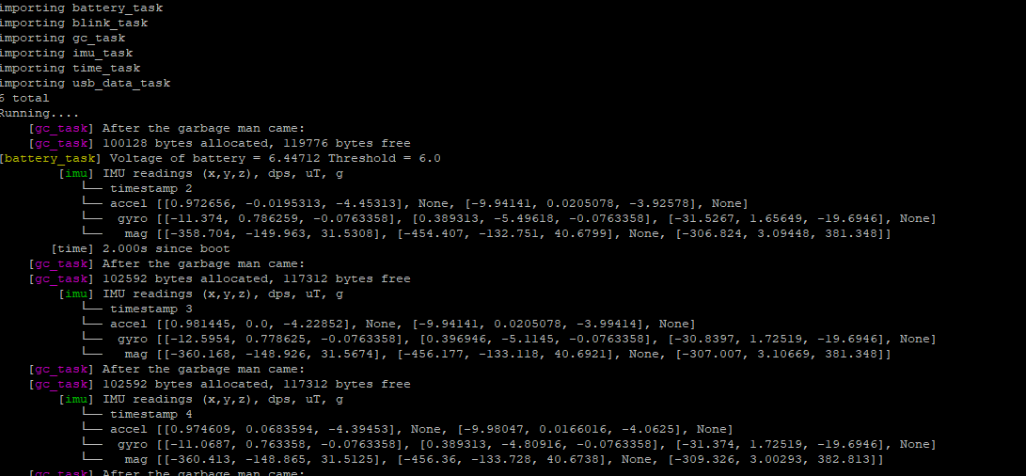
REPL terminal and data stream
Regular circuitpython terminal.
Cubesat.debug prints data here
Print() command also prints here
Ctrl-C to end and ctrl-D to reload

Slide 23
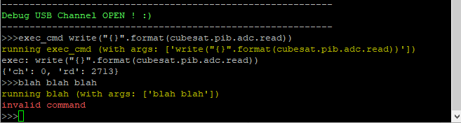
Debug command terminal
First asci encoded word “exec_cmd” is the keyphrase for the command to run
Then “ “ space for arguments passed
All arguments are separated by “arg0,arg1” comma right now, not “arg0, arg1“ comma space
Not implemented yet, but this is where the device will also ask for simulation data

Slide 24
Main Operation Modes of Satellite
Each mode will have several substates.
Each mode/state will probably have specific tasks/ change task settings on the fly.
STARTUP MODE
SAFE MODE
IDLE MODE
PAYLOAD MODE
Runs once, x amount of time after initial deployment
Deploys deployables
Initial system checkout and startup
i.e. ADCS detumble,
ADCS calibrate,
ETC.
Turns everything off, sleeps for x amount of time when it will re-check everything and try to re-enter idle mode.
Probably will beacon once for help during this. An override function may be implemented
Device in this mode most of time.
Will beacon over LoRa looking for commands from ground.
Payload will be powered off.
ADCS in point mode
Initiated from idle mode to start payload experiment.
Recieves data stream over LoRa for next arm/exec command
Sends data stream down of payload camera, arm, and important telemetry.
ADCS in payload_comp() mode, where it will hold and try to ignore arm torque exerted. (Low priority)
If time, implement where cubesat will point at ground for better data transmission and reception.
I have a baseline experiment with a few free-running tasks right now, but this may need to be moved to a more discrete “frame”-like interface…

Slide 25
STARTUP Mode
Wait x amount of time
Deploy antenna
Preform initial ADCS calibration
Do initial device checkout
Initiate first downlink

Slide 26
Safe Mode
Turns all non-critical devices off.
Checks periodically for exit criteria to return to idle mode.
Will beacon SOS as a last resort

Slide 27
Idle Mode
Will spend most time here.
ADCS will be running
Beaconing every so often to try to initiate contact with ground station

Slide 28
Payload Mode
Checks Rx port for latest command data.
Mostly user inputs from website
Sends data to payload and executes commands
When a photo is requested from GS, the sat will burst down a photo

Slide 29
Over the Air (OTA)(Radio) Commands
Separate packet structures for 2 modes, beacon and connected.
RadioHead is the background library used by the GS and the sat. It does most of the handling for a header and ACK response.
The Satellite will receive commands from the ground-station less than 240bytes.

Slide 30
Default “Beacon Mode” Radio Mode
Satellite
Ground Station
Transmit Beacon
Receive Data?
No
Recieve response?
No
Yes
Send Command
Yes
Execute Command
Transmit Response

Slide 31
Default “Beacon Mode” Radio Packet Structure
Transmit / Receive both sides
RadioHead Header
4 Bytes
Super Secret Code
X bytes
Our Header
2 bytes
Command / response code
2 bytes
Args
Command
2 bytes
…..

Slide 32
High-Speed “Connected” Radio Mode
Runs at frequency passed by start connected mode cmd
Satellite
Connected Mode START
Burst Mode?
Buffer Ready?
Yes
Yes
Send Buffer
Increment Timeout Counter
No
Last Byte?
Listen
Connected mode will often be terminated by a command.
No
Heard? Some-thing?
Timeout Trigger?
Yes
Execute CMD
Yes
Yes
End burst mode
End Connected Mode

Slide 33
“Connected Mode” Radio Packet Structure
Burst Transmit
RadioHead Header
4 Bytes
Super Secret Code
X bytes
Header
6 bytes
Data
Args
Command
2 bytes
…..
Receiver will not respond until the burst is over!

Slide 34
Our Header Structure
Bytes 1-2 : Flags (i.e. listen again, last transmission, etc…)
Idea: have a multi-packet flag for the radio to listen again and look for packet number bytes?
Bytes 3-4 : packet number
Bytes 5-6 : number of packets to send

Slide 35
Minimum Functionality (Payload)
Phase 1 goal overview
GS
Sat
Send Payload Init command
Send response (yes/no)
Tx control data at x freq
Rx command/control data
Yes
img cmd Rx?
Rx done?
No
No
Yes
Rx image data
Tx burst image data down

Slide 36
adcs_task.py
Consult CryoCube code, Dr. Walker’s Dissertation, and Dr. Walker for details

Slide 37
payload_task.py
Initated by command payload_start:
This only gets camera data from the openMV if the img_burst flag is true. Otherwise, it will do nothing.
Other payload management tasks can go here
Img burst flag?
Send_buf flag?
Place next chunk in buffer
Set send_buf flag
Start
Yes
No

Slide 38
db_cdh.py / usb_data_task.py
Debug commands sent via host PC
implement ability to run regular flight cdh.py commands with normal output over radio and debug info via USB.

Slide 39
cdh.py
All of the “in flight” commands will go here.
setting persistent settings, imitating payload, printing log, printing telemetry, etc.
Some commands like exec, query, and hreset will probably have to be password-protected in addition?

Slide 40
Radio tasks
Radios beacon unless they are “connected”
Connection is a command sent where the GS specifies a frequency to check for new messages
During this, they will explicitly listen unless prompted to burst data down by GS

Slide 41
Telemetry gathering tasks
Imu_task.py
Reads IMU data and overwrites data in cubesat.data_buffer{“imu”}.
GPS_task.py
Reads GPS data and overwrites data in cubesat.data_buffer{“gps"}
Temperature_task.py
Reads various temperatures and overwrites data in cubesat.data_buffer{“temp”}
Turns overheating devices off.
Time_task.py
Prints time data.
Battery_task.py
Gathers battery information and power readings. Initiates safe mode if low battery is detected.

Slide 42
Housekeeper task
Detects errors on satellite and attempts to fix them.
Preforms a daily hard reset to the satellite
Other housekeeping tasks?
gc_collect is already its own thing running at 2Hz
Maybe separate this into its own error handling tasks
I’ve yet to decide if this should be one or many tasks…

